Slide 1
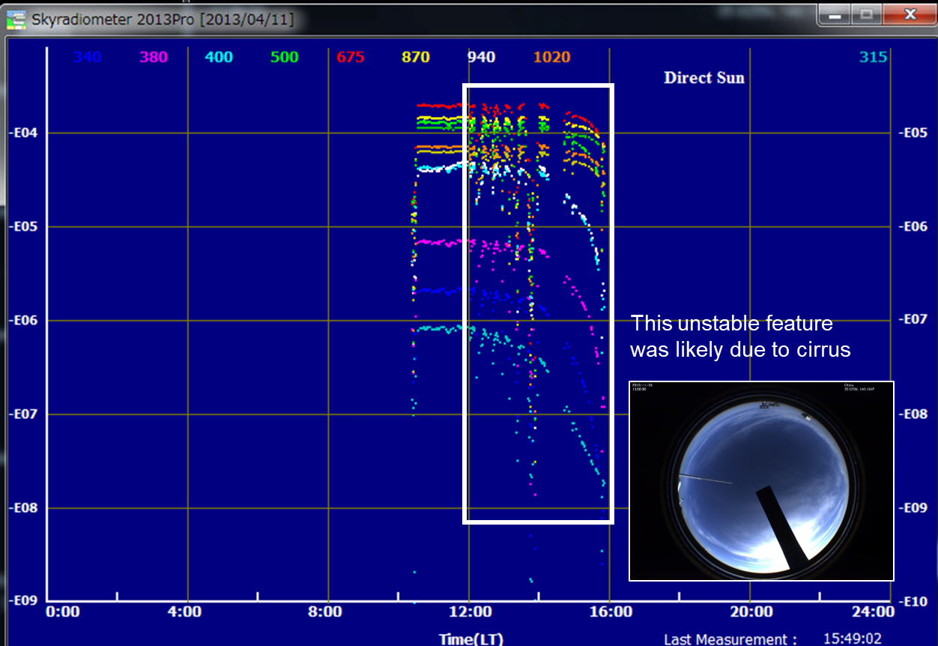
Cloud (cirrus) screening for skyradiometer
data has been done reasonably?
20191118
MAX-DOAS aerosol extinction (AEC) data (476 nm)
North
West
East
aerosols@high altitude
or clouds?
South
AEC smaller at 12-13LT than at 11-12LT,
opposite to the skyradiometer data

Slide 2
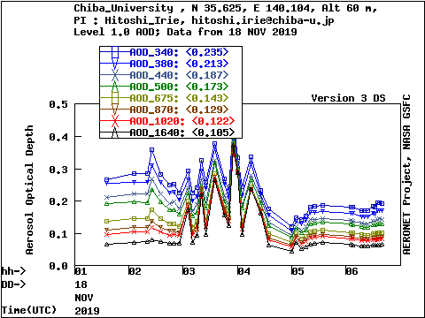
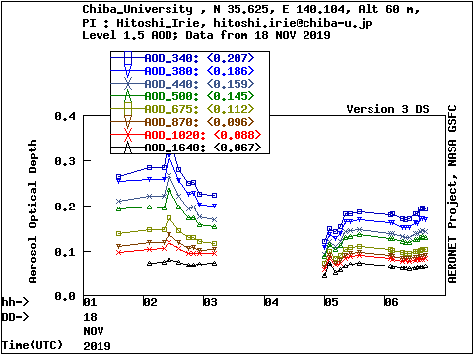
Comparison of SKYNET vs. AERONET AOT data
20191118
SKYNET
skyradiometer
AERONET
CIMEL
Lv1
Lv1.5
cloud screening reasonable or too severe?

Slide 3
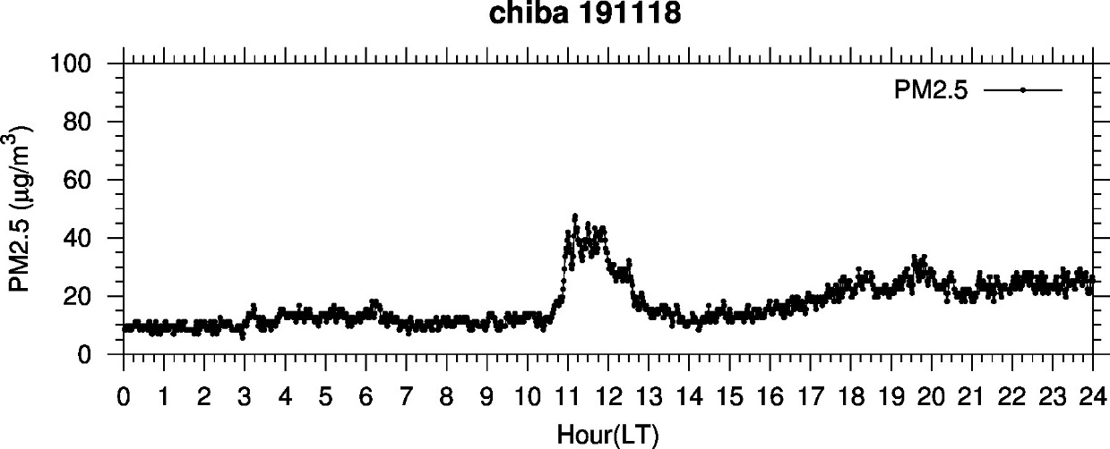
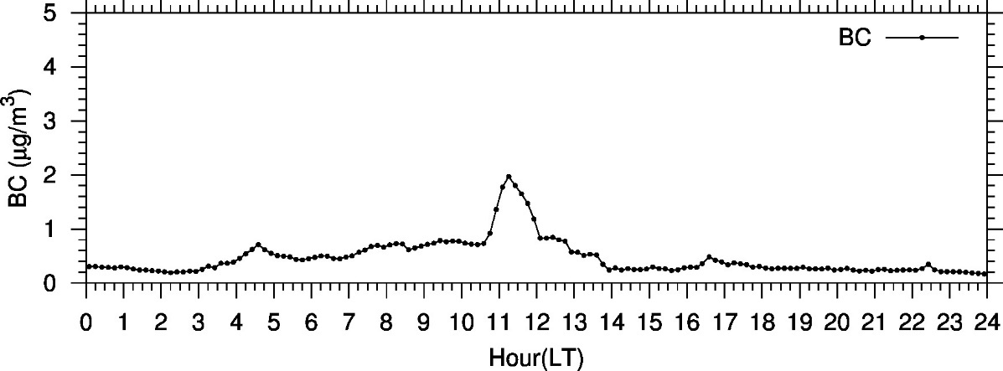
Enhancements of PM_{2.5}, BC, and SO₂
MAX-DOAS SO₂
North
West
East
South
No data

Slide 4
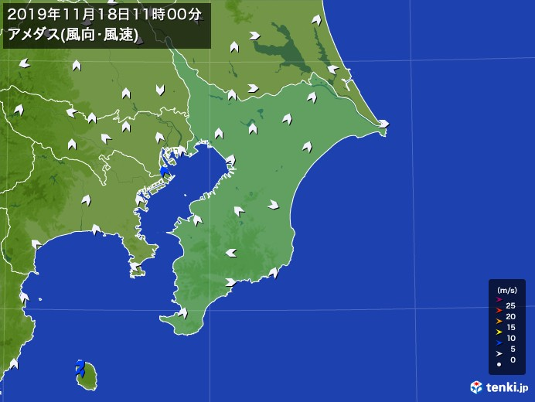
Wind data at 11am on Nov. 18

Slide 6
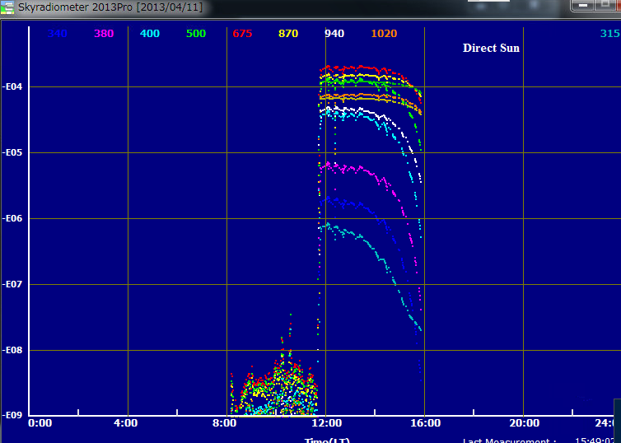
Skyradiometer raw data (20191119)
Cloudy
Sunny

Slide 7
Calm condition in the morning of Nov. 19

